Slide 1
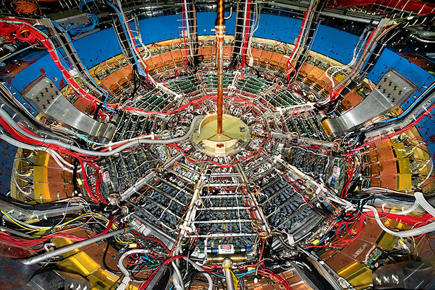
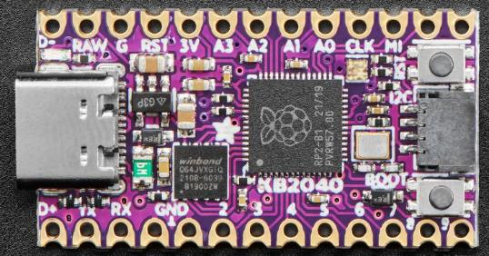
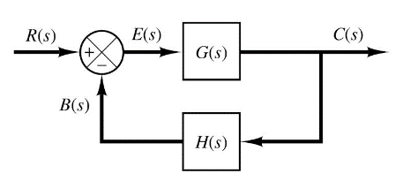

Control Systems
Engineering
(CSE 201)
Student #1
Student #2
Student #3
Team 10
Electromagnetism
Biot-Savart Law

Slide 2
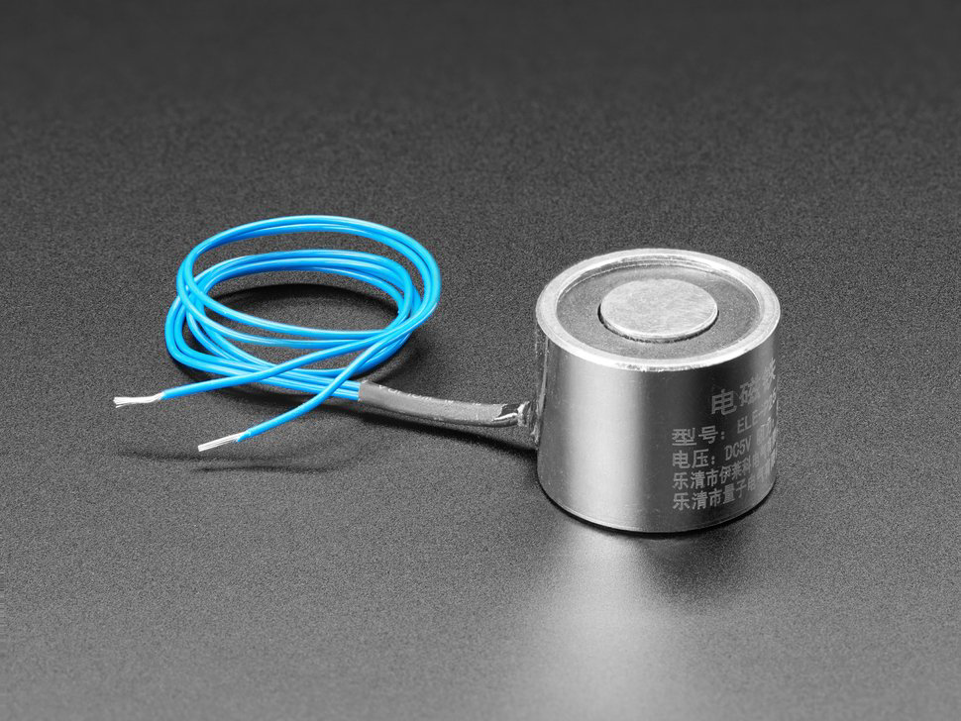
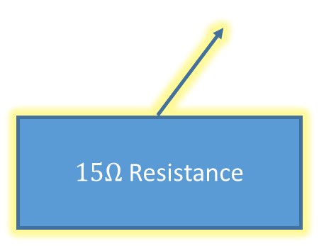
Our Challenge: Measure An Electromagnet
Show that the strength of an electromagnet depends on its supplied current
$15Ω$ Resistance

Slide 3
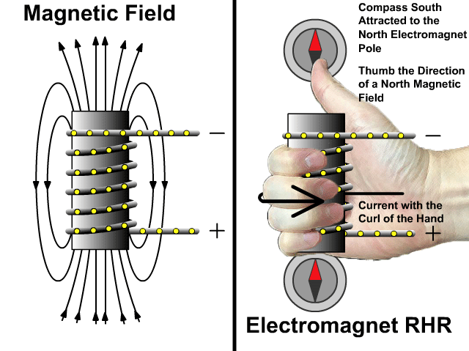
Electromagnetism

Slide 4
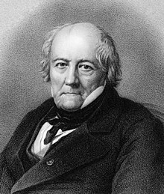
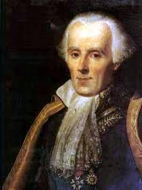
The Biot-Savart Law
Coulomb's Law relates static electric fields to the point charges which are their sources
The Biot-Savart Law relates static magnetic fields to the currents which are their sources
Finding the magnetic field resulting from a current distribution involves the vector product and is inherently a calculus problem if the distance from the steady current to the magnetic field point is continuously changing
Jean-Baptiste Biot
1774-1862
Félix Savart
1791-1841

Slide 5
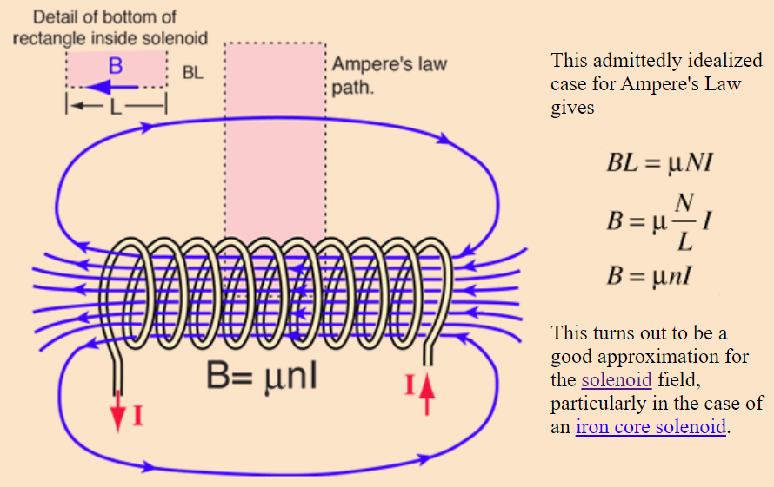


The Biot-Savart Law
$$μ=k×μ_{0}$$
n is # of turns per unit length
(turn "density")
$k$ = relative permeability of the solenoid core
For a coiled electromagnet

Slide 6
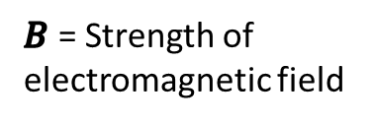
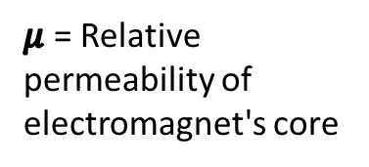


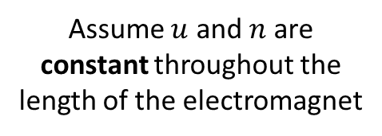
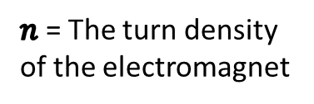
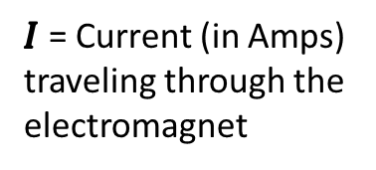
The Biot-Savart Law
$B$ = Strength of electromagnetic field
$$B=μ×n×I$$
$μ$ = Relative permeability of electromagnet's core
Assume $u$ and $n$ are constant throughout the length of the electromagnet
$n$ = The turn density of the electromagnet
$$y=m×x$$
$I$ = Current (in Amps) traveling through the electromagnet
As we increase current (I) flowing through the electromagnet, the magnetic field strength (B) of the electromagnet should rise at a linear rate

Slide 7
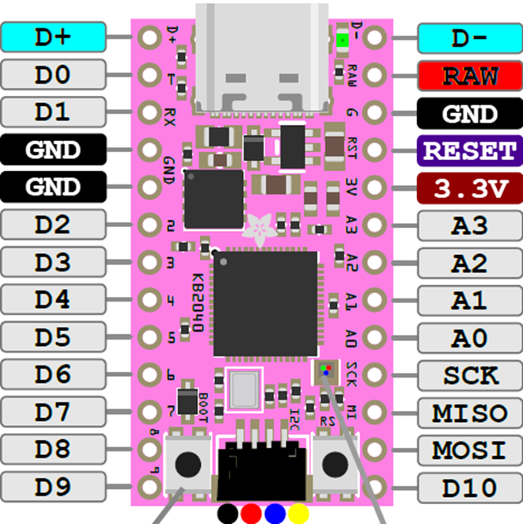
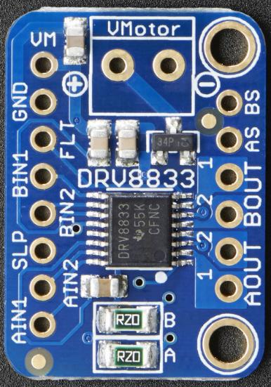

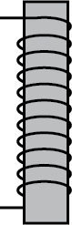
We Needed a Motor Driver
1KΩ
The KB2040 can kill the power to the electromagnet by putting the DRV8333 into sleep mode by asserting the SLP pin (D6 on MCU)
The KB2040 can set the output voltage of the DRV8833 using pulse width modulation (PWM) on pins D7 and D8

Slide 8
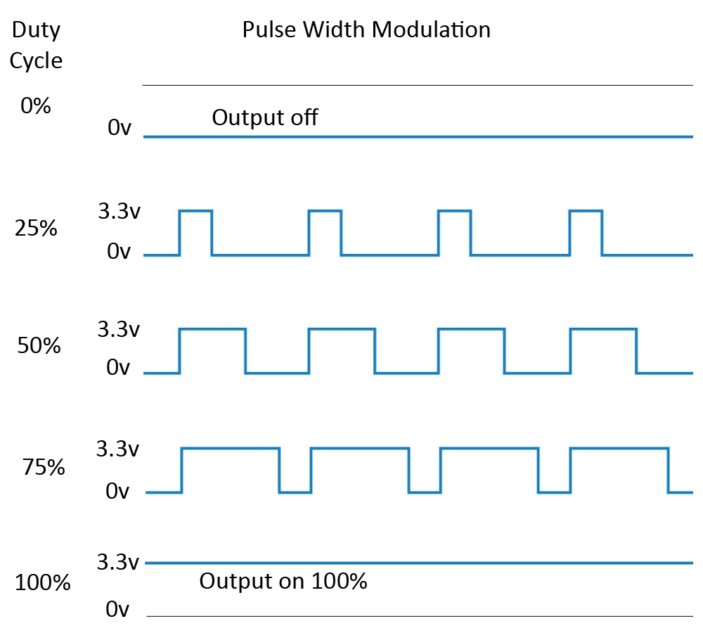





Digital to Analog Conversion via PWM
$$0V$$
$$3.3×0.25=0.825V$$
$$3.3×0.50=1.65V$$
$$3.3×0.75=2.48V$$
$$3.3V$$

Slide 9
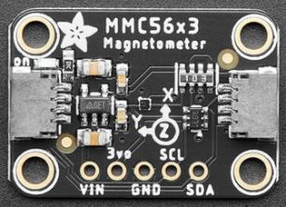
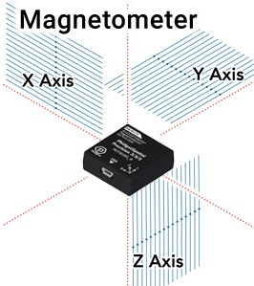

Triple Axis Magnetometer
Because the magnetic fields at the end of the electromagnet extend in all three dimensions, we used this formula to find the total magnitude (strength) of the field:
$$M_{TOTAL}=\sqrt{{M_{x}}^{2}+{M_{y}}^{2}+{M_{z}}^{2}}$$

Slide 10
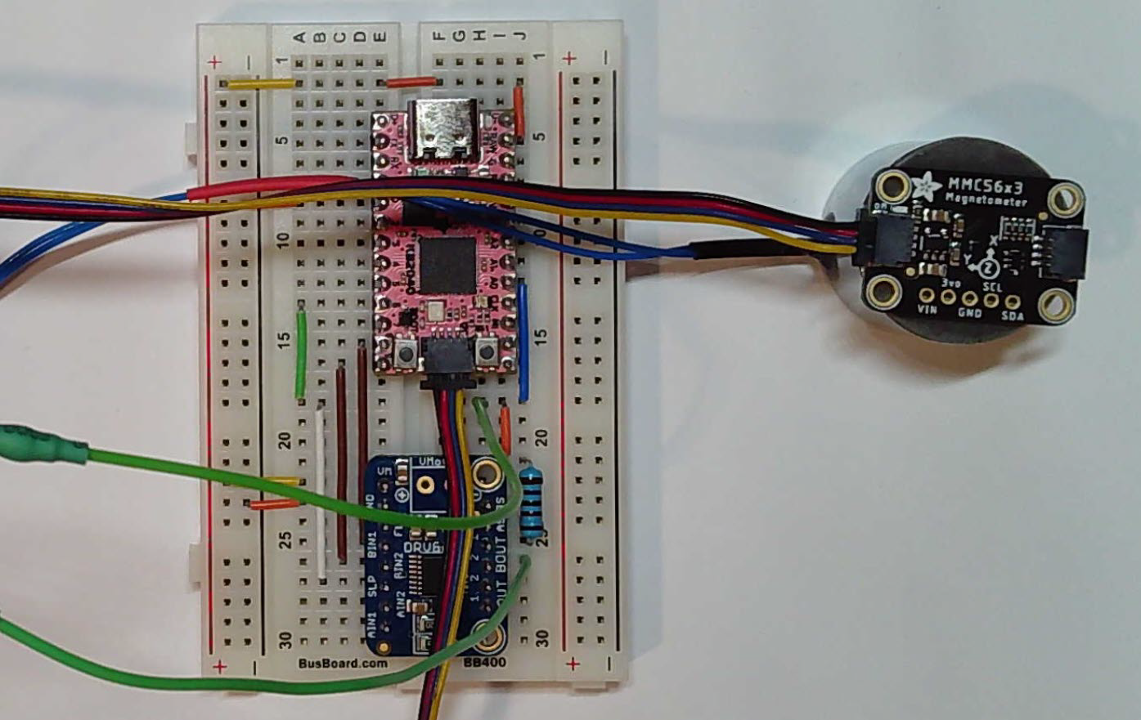
Our Approach

Slide 11
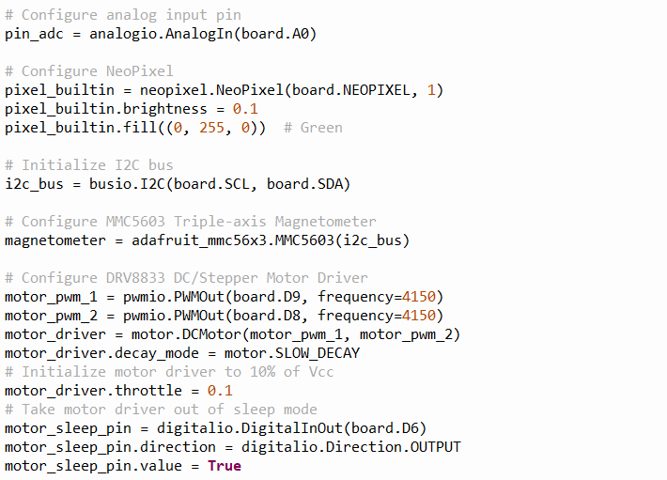
Our Solution
①
②
③
④
⑤
⑥
⑦
⑧
⑨
⑩

Slide 12
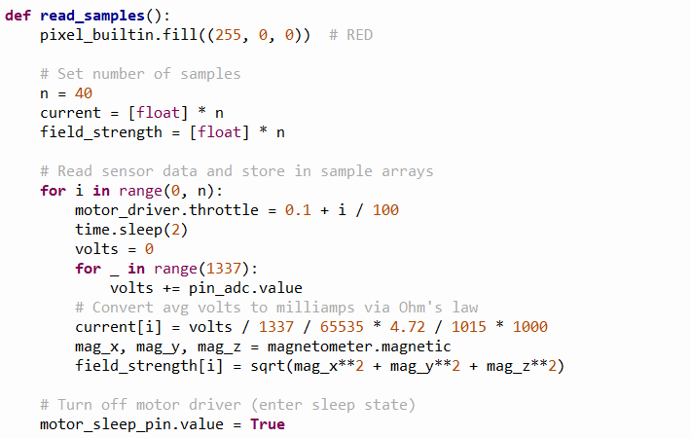

Our Solution
①
②
③
$$10\%→50\%$$
④
Use a prime number to avoid aliasing with the PWM voltage waves
⑤
⑥
⑦
⑧

Slide 13
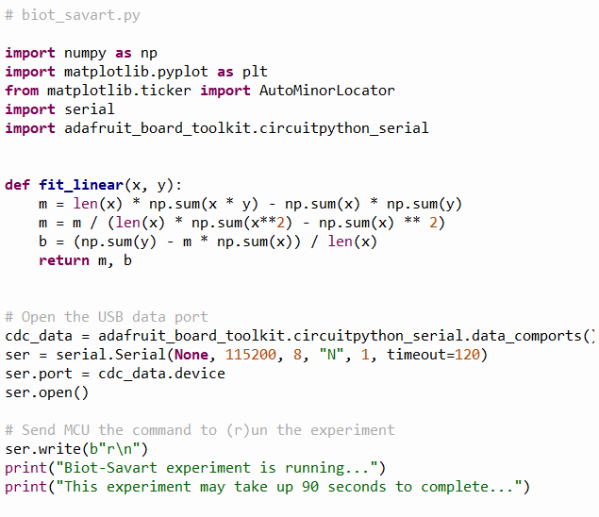
Our Solution
①
②
③

Slide 14
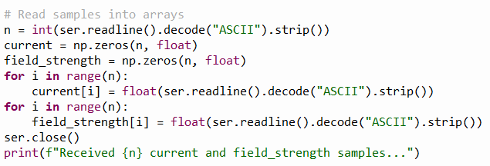
Our Solution
①
②
③
④

Slide 15
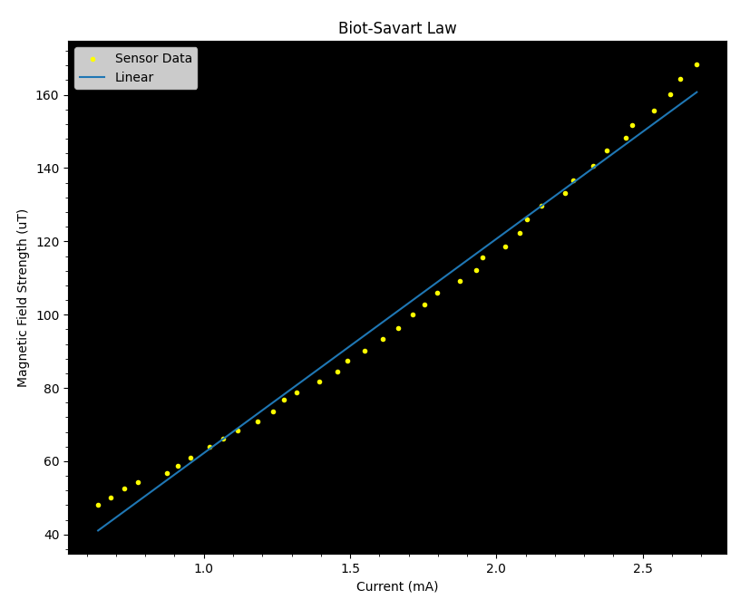

Our Results
$$B=μ×n×I$$
constants
There appear to be some small non-linear effects in our setup that we need to further investigate

Slide 16
Team 10 – What We Learned
The magnetic field lines within a solenoid (such as a coiled electromagnet) are all parallel but loop around at either end of the coils
From the Biot-Savart law, the strength of the magnetic field in a solenoid is directly proportional to the current flowing through the electromagnet coils
We can use the 5V taken directly from the USB port on the laptop to power a motor driver, which in turn pushes the current through the electromagnet
We can control the motor driver using PWM signaling
We can measure magnetic field strength at the end of the electromagnet using a 3-axis magnetometer

